Slide 1




Introduction to AngularJS
A super-heroic JavaScript Framework

Slide 2
Table of Contents
What, why, who and how?
Resources
Hello World application
Live demo – Event Registration SPA App
Where to start – Angular Seed
Modules and ngApp

Slide 3

What, why, who and how?

Slide 4
What, why, who and how?
MV*-based JavaScript framework
Model – represents data
View – represents information to the user
* - can be controller, presenter, view model

Slide 5
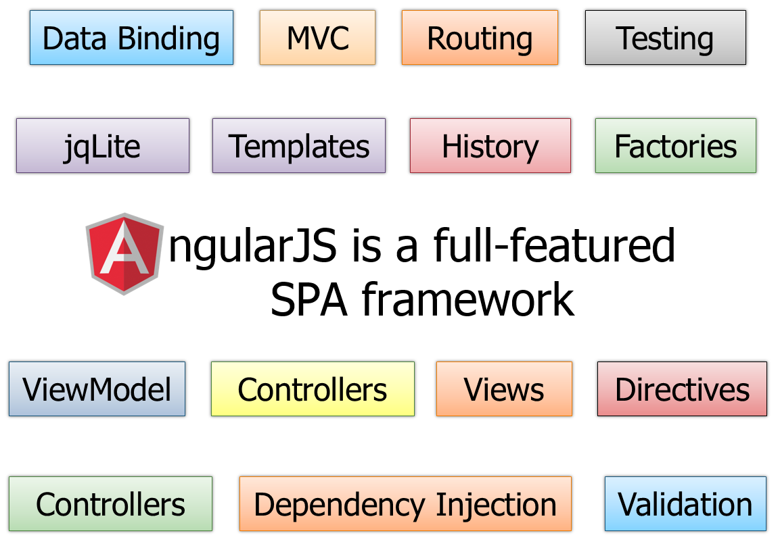
What, why, who and how?
Angular JS features:
MV*
Open Source
Comprehensive
Testable
Extends HTML
Forward Thinking

Slide 6


What, why, who and how?
Angular JS architecture:
Two-way binding
Dirty checking
Dependency injection
Angular components
Services
Controllers
Views / Directives

Slide 7

Resources

Slide 8
Resources
http://angularjs.org/
http://docs.angularjs.org/api
https://github.com/jmcunningham/AngularJS-Learning
http://fastandfluid.com/publicdownloads/AngularJSIn60MinutesIsh_DanWahlin_May2013.pdf
https://www.youtube.com/watch?v=i9MHigUZKEM

Slide 9
Hello World Application
Live Demo

Slide 10

Creating a SPA App

Slide 11
Music Artists SPA App
We will create a SPA application:
Registration / Login
Create new artists and songs
Edit artists and songs
Artists details
Listing of all artists
Server

Slide 12
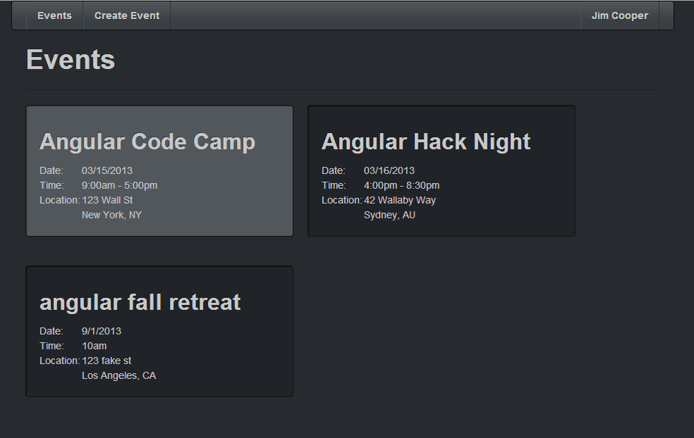
Music Artist SPA App

Slide 13

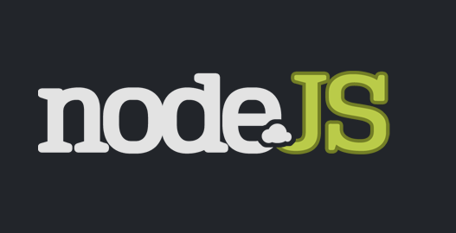

Tools
We will use:
AngularJS 1.3.0-beta.2 (latest version)
Command Prompt (for server purposes)
WebStorm (you can use any IDE)
NodeJS (server-side technology)

Slide 14
Angular Seed
What is Angular Seed:
Official starting point template
Works for small startup applications
It has good organization and architecture
Comes with basic server (NodeJS)
Get it from: https://github.com/angular/angular-seed

Slide 15
Angular Seed Modification
Modify Angular Seed
Remove not-needed files
Add jQuery, UnderScore.js, Bootstrap
Get server ready
Add folder for Controllers, Directives, etc.

Slide 16

Modules and ngApp

Slide 17
Angular Modules and ngApp
Modules
Like different applications
Used only where needed in the HTML
// JavaScript
var myApp = angular.module('myApp', ['dep_1', 'dep_2']);
// HTML
<div ng-app="myApp">
<div ng-controller="myController">
<h1>{{header}}</h1>
</div>
</div>

Slide 18
AngularJS
http://academy.telerik.com

